Slide 1
Division 5 Hot Mix Asphalt Pavements & Surface Treatments

Slide 2
Division 5 Revision Overview
FUSP Changes
501 – Reduction of HMA Mixes
502 – Terminology and Pay Items
504 – Application and Pay Items
505 – Double Chip Seal

Slide 3
FUSPs Incorporated Into 2020 Spec Book
501BB – Safety Edge
501FF – Low Tracking Bond Coat Emulsified Asphalt
501GG – Cold Milling Hot Mix Asphalt Surface
501L – Temporary Hot Mix Asphalt Pavement Quality and Compliance
502B – Hot Mix Asphalt Crack Treatment and Overband Crack Fill
504B – Micro-Surfacing Corporations (Rumble Strips)
Minor Changes to Tables 501.1, 501.4, 902.5, 902.7,and 902.8

Slide 4
Section 501 Plant Mixed HMA

Slide 5
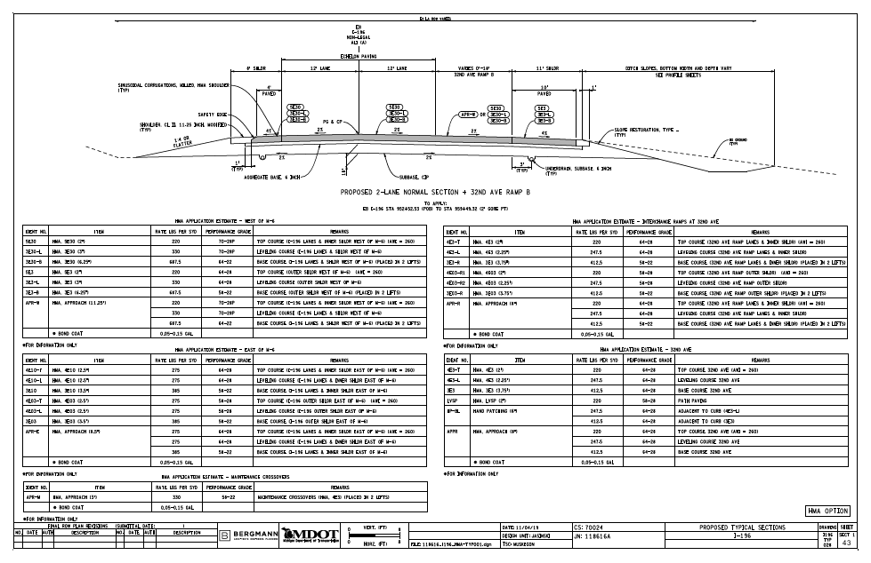
Reduction of HMA Mixes
LVSP and E03 combined into EL
E1 and E3 combined into EML
E10 and E30 combined into EMH
E50 eliminated and replaced with EH
Gap Graded Superpave (GGSP) renamed to Stone Matrix Asphalt (SMA) to be consistent with national standards

Slide 6
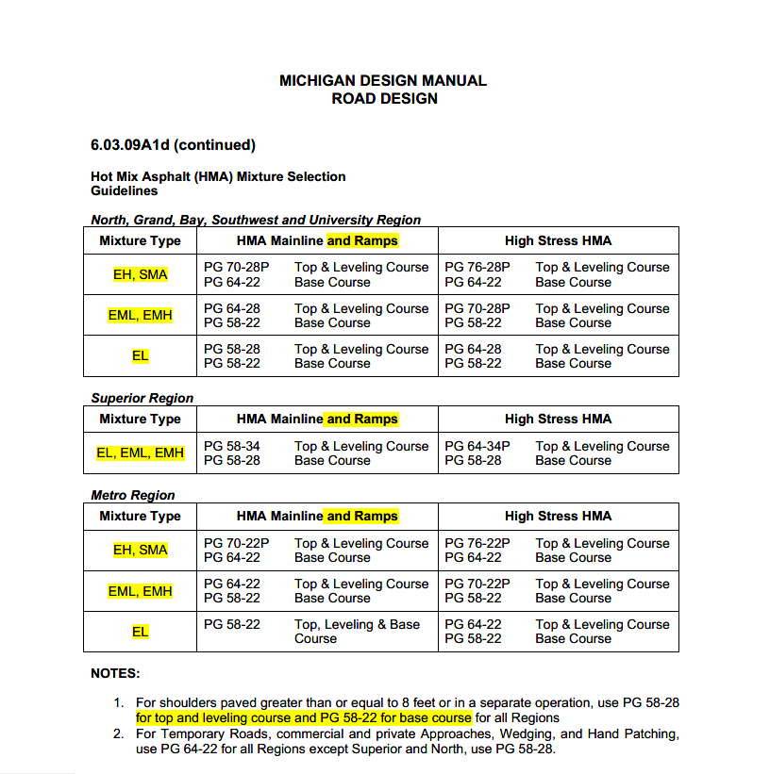
Reduction of HMA Mixes
Major Changes Made to Tables 501.2, 501.3 and 902.6
New Mix Design Designations
Changes mostly relevant to Mix Designers
Minor changes to Tables 501.1, 501.4 and 902.5
Incorporation of FUSP 501BB, 501 FF, 501 GG, and 501 L
Changes made to Hot Mix Asphalt (HMA) Mixture Selection Guidelines in the Road Design Manual

Slide 7
Section 502 HMA Crack Treatment

Slide 8
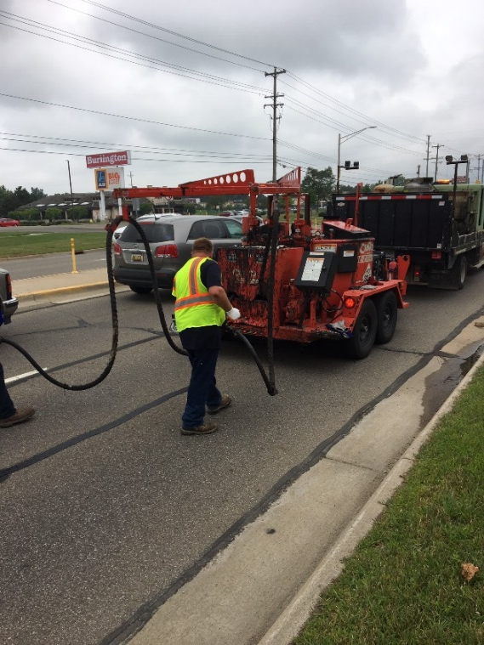
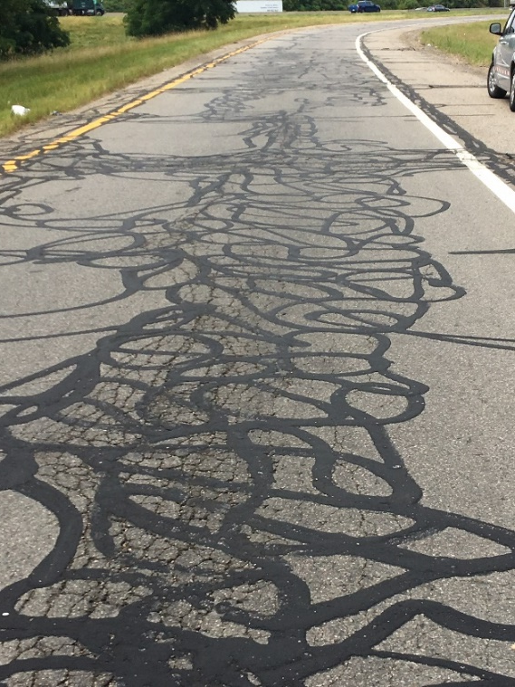
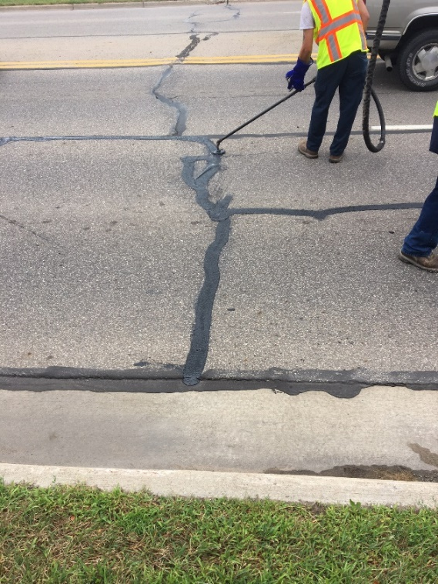
Terminology and Pay Items
Working Crack → Primary Crack
HMA Crack Treatment vs Overband Crack Fill
Incorporated FUSP 502B
Pretreatment requirements if not standalone
Updated pay items

Slide 9
Section 504 Micro-Surfacing

Slide 10
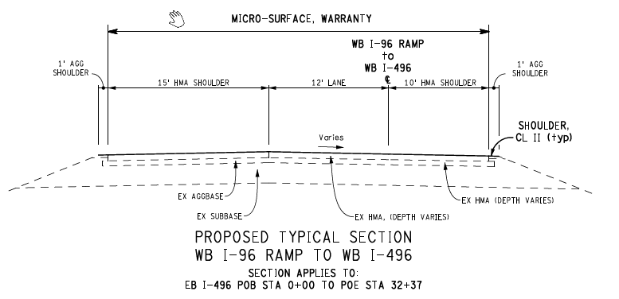
Application and Pay Items
Application width of Micro-Surface
Confusion if shoulders were included
As indicated on the plans
Incorporation of FUSP 504B
Centerline and shoulder corrugations
Pay Items
Micro-Surface, Rutfill Ton
Micro-Surface Syd
Micro-Surface, Single, Cse Syd
Micro-Surface, Longitudinal Ft

Slide 11
Section 505 Chip Seals

Slide 12
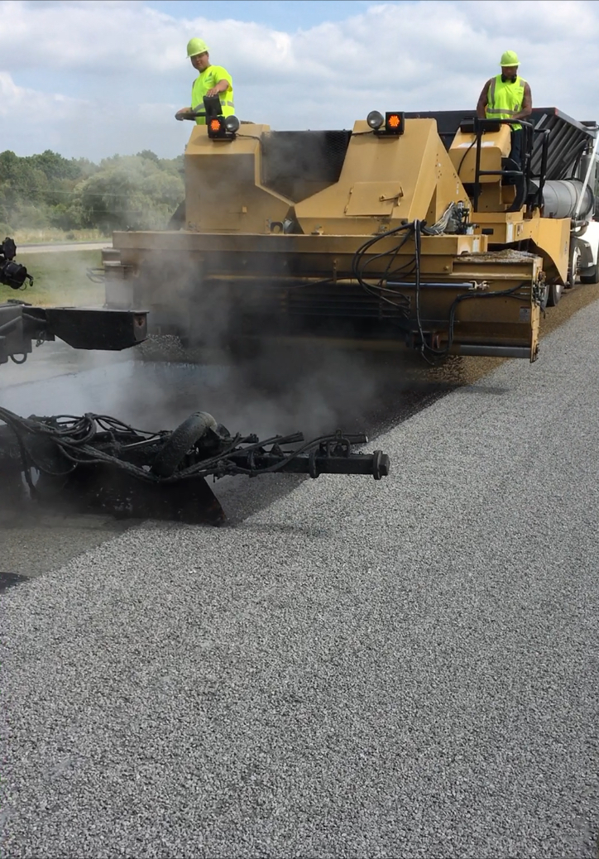
Double Chip Seal
Double Chip Seal seasonal limitations
Lower peninsula south of M-46
August 1st → September 1st
Incorporate FUSP 506B
Include CST aggregate
Tables 902.7 and 902.8
Pavement marking removal not included
Special markings

Slide 13
Division 6 Portland Cement Concrete for Pavements

Slide 14
Division 6 Revision Overview
FUSP Changes
601 – Reserved
602 – Concrete Grades and Pay Items
603 – Pay Items
604 – Removed
605 – Removed

Slide 15
FUSPs Incorporated Into 2020 Spec Book
602B – Jointing layout plan for intersections
602D – High performance PCC pavement (Division 10)
602E – PCC pavement, bridge approach, reinforced
602I – Coatings for dowel bars, modified (914)
603A – Longitudinal grooving of concrete pavement
604A – QC and acceptance of PCC (For Local Agency Only) (Division 10)
604B – QC and acceptance of PCC (Division 10)

Slide 16
Section 601 Portland Cement Concrete for Pavements

Slide 17
Reserved Moved To Section 1001

Slide 18
Section 602 Concrete Pavement Construction

Slide 19
Concrete Grade and Pay Items
Concrete Grades Changing
Incorporated FUSP 602B, 602D, 602E and 602I
Pay Items associated with old FUSPs
Mix Table Conversion
New Concrete Grades | 3000 | 3500 | 3500HP | 4000 | 4000HP | 4500 | 4500HP
Old Concrete Grades | S3, P2 | S2, P1, T | S2M, P1M | S1 | S1M | D | DM

Slide 20
Section 603 Concrete Pavement Restoration

Slide 21
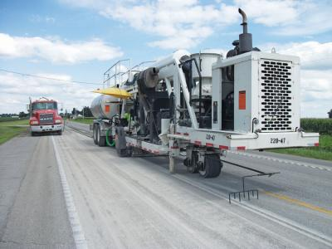
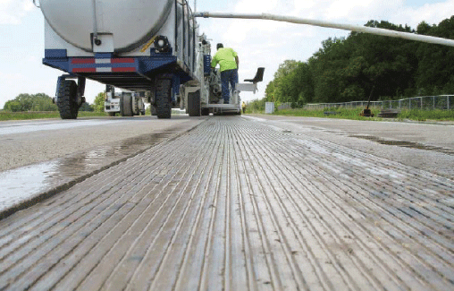
Pay Items
Incorporated 603A
Diamond Grooving Conc Pavt
Diamond Grinding and Grooving Conc Pavt

Slide 22
Section 604 Contractor Quality Control for Concrete

Slide 23
Removed Moved To Section 1002

Slide 24
Section 605 Quality Assurance for Concrete

Slide 25
Removed Moved To Section 1003

Slide 26
Questions

