Slide 1
2020 Spec Book Division 7
Brad Wagner
Chief Structure Design Engineer
John Belcher
Bridge Construction Engineer
Notes:
John I co-chairs of Div 7 (way I remember)

Slide 2
Spec Book Review – Major Themes
Incorporate
Errata
FUSP’s?
PASP’s?
What has caused issues?
What can be improved upon, clarified?
What is not in line with current practice?
Notes:
So how did we approach this.
24 ppl
design/construction/fabrication/materials/Geotech/coatings/QA/LAP.
Since we started this, 11 ppl left, leaving john as expert in like 5 of the areas mentioned.
Errata, fusp, pasp.
Initially, 75 hours, reading line by line.
Id’d issues, possible improvements, out of date practices.
In come cases - just changed words for fun, to make people wonder why

Slide 3
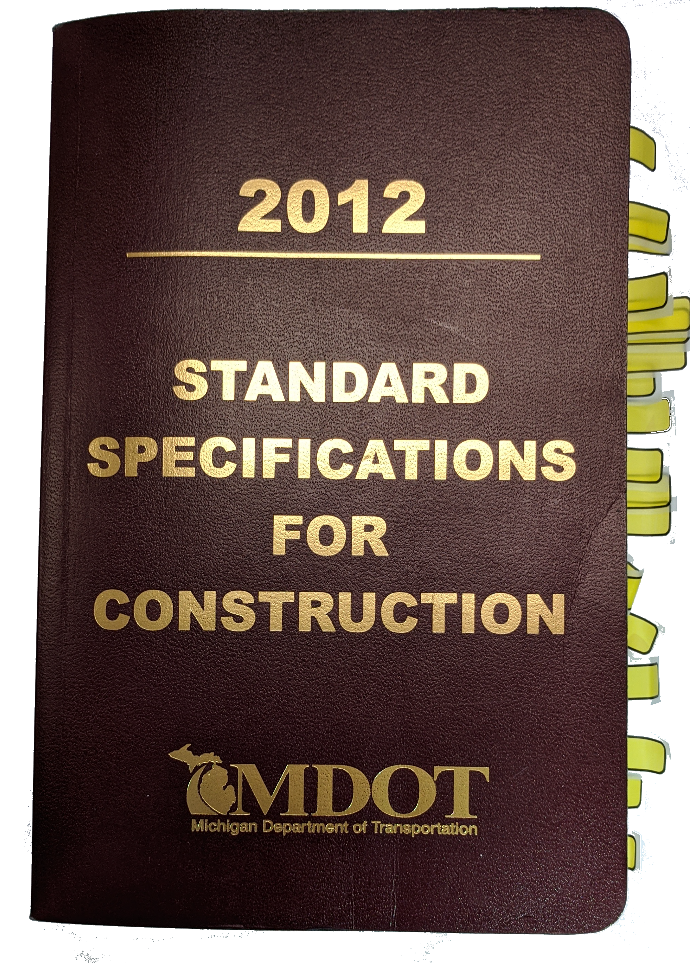
Division 7 Sections
701 Portland Cement Concrete for Structures
702 Mortar and Grout
703 Mortar and Concrete Patching, Repair, and Resurfacing Mixtures
704 Steel Sheet Piling and Cofferdams
705 Foundation Piling
706 Structural Concrete Construction
707 Structural Steel Construction
708 Prestressed Concrete
709 Timber Structures
710 Waterproofing & Protective Covers
711 Bridge Railings
712 Bridge Rehabilitation – Concrete
713 Bridge Rehabilitation – Steel
714 Temporary Structures and Approaches
715 Cleaning and Coating Existing Structural Steel
716 Shop Cleaning and Coating Structural Steel
717 Downspouts and Drains
718 Drilled Shafts
Notes:
Just to give everyone a frame of reference – pillow
Sections of division 7.
18 subsections, 160 pages, second largest, most comprehensive

Slide 4
Division 7 Sections
701 RESERVED Cement Concrete for Structures
702 RESERVED and Grout
703 RESERVED Concrete Patching, Repair, and Resurfacing Mixtures
704 Steel Sheet Piling and Cofferdams
705 Foundation Piling
706 Structural Concrete Construction
707 Structural Steel Construction
708 Prestressed Concrete
709 Timber Structures
710 Waterproofing & Protective Covers
711 Bridge Railings
712 Bridge Rehabilitation – Concrete
713 Bridge Rehabilitation – Steel
714 Temporary Structures and Approaches
715 Cleaning and Coating Existing Structural Steel
716 Shop Cleaning and Coating Structural Steel
717 Downspouts and Drains
718 Drilled Shafts
Notes:
2020 will now have 15 sections.
old is new again. ode to the 1990 manual, concrete now has it’s own section, Division 10.
Tim Stallard and Ethan Baumer will discuss after we’re done.
Painful amount of discussion about what to do with 701-703.
701-703 are now “reserved”, cause you never know, say in 2050?

Slide 5
Frequently Used Special Provisions
705A PILE SPLICING
706A REINFORCEMENT, STAINLESS STEEL
706C HIGH PERF PCC BRIDGE DECK (GRADE DM)
706E HIGH PERF PCC PAVEMENT, BRIDGE APPROACH, REINFORCED (GRADE DM or P1M)
711C HIGH PERF PCC TEXTURED AESTHETIC BRIDGE RAILING (GRADE DM)
706G HIGH PERF PCC BRIDGE SUBSTRUCTURE (GRADE S2M)
711D HIGH PERF PCC BRIDGE RAILING (GRADE DM)
707B FRACTURE CRITICAL MEMBERS
707F STRUCTURAL STEEL CONSTRUCTION REVISIONS
708A STRAND DEBONDING
708B PRESTRESSED CONCRETE BULB-TEE BEAM
711A BRIDGE BARRIER RAILING, MODIFIED
711B TEXTURED CONCRETE AESTHETIC BRIDGE RAILING
711E BRIDGE RAILING REVISIONS
714A TEMPORARY STRUCTURES AND APPROACHES REVISIONS
716A SHOP CLEANING AND COATING STRUCTURAL STEEL REVISIONS
Notes:
Division 7 had 40 FUSP’s. We incorporated everyone we could, 16 in total.
During the course, created 3 more fusp’s – wanted to get language out ther before spec book.
Reasons for not incorporating include:
* Include forms or QA plan (heat straightening, Pile QC)
Approved supplier list – (polyurethane sealant)
Too new
Or are under major revisions
Her are the ones we incorporated:

Slide 6
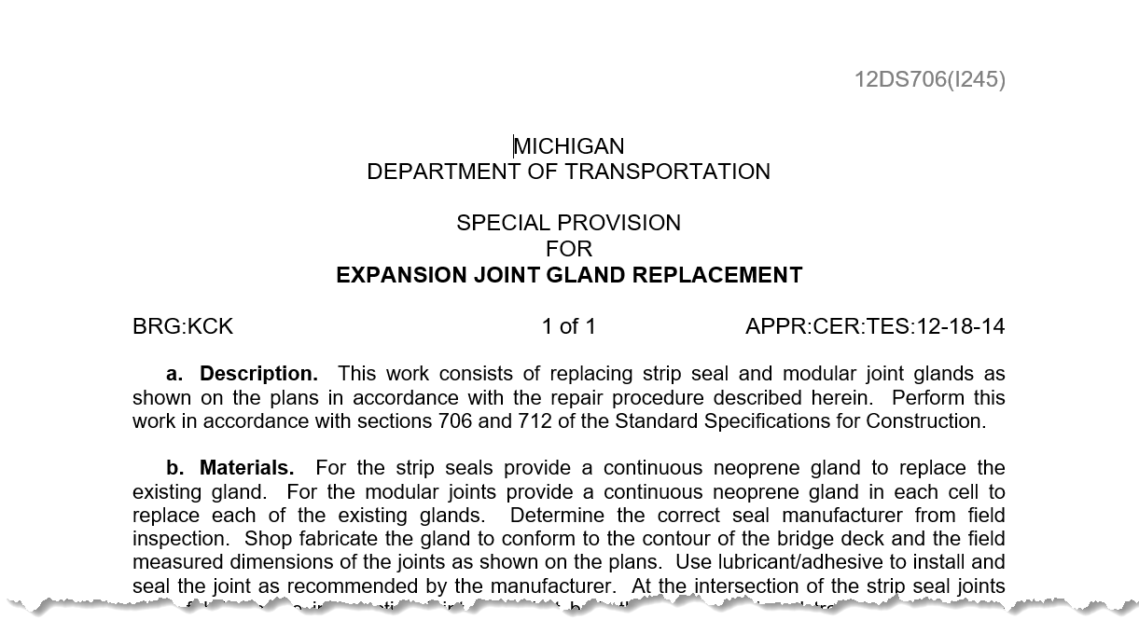
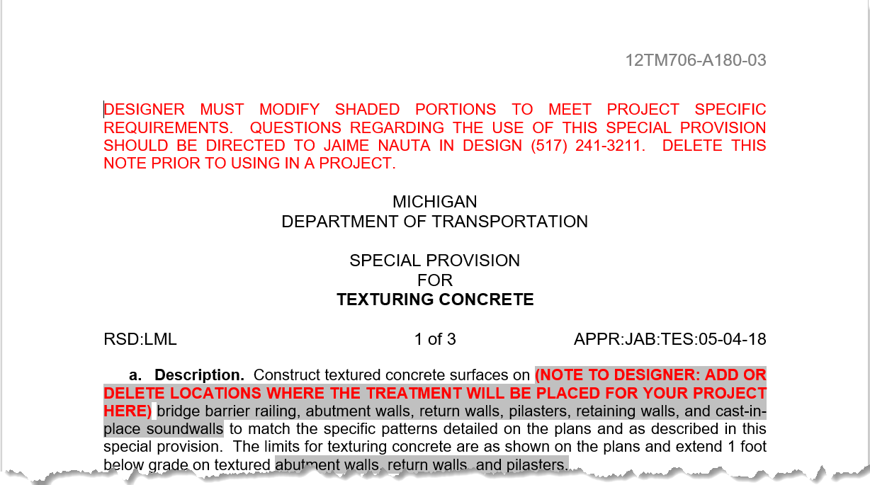
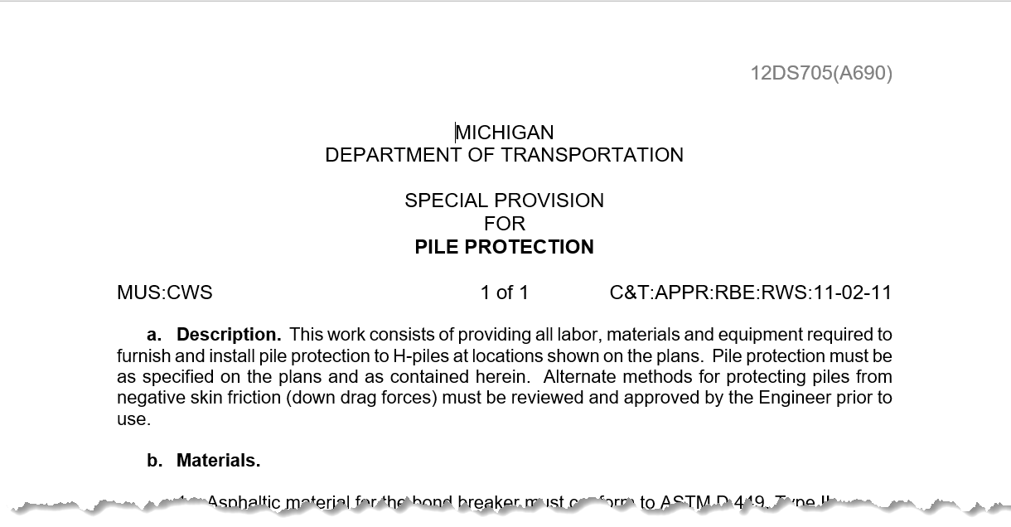
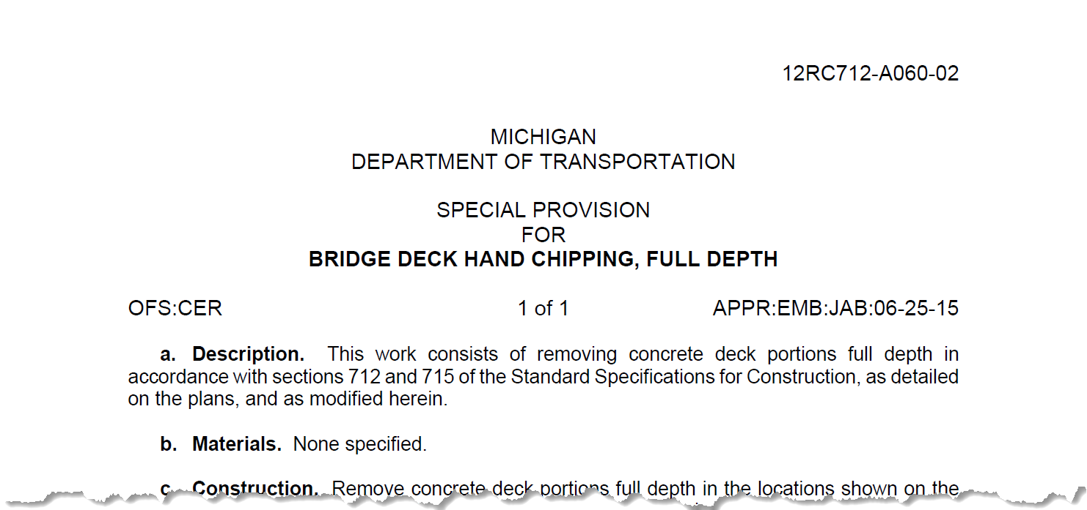
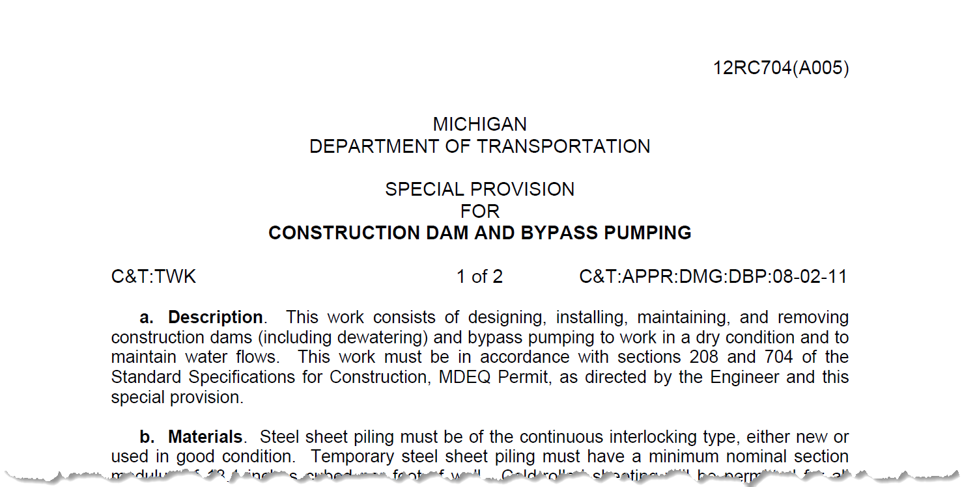
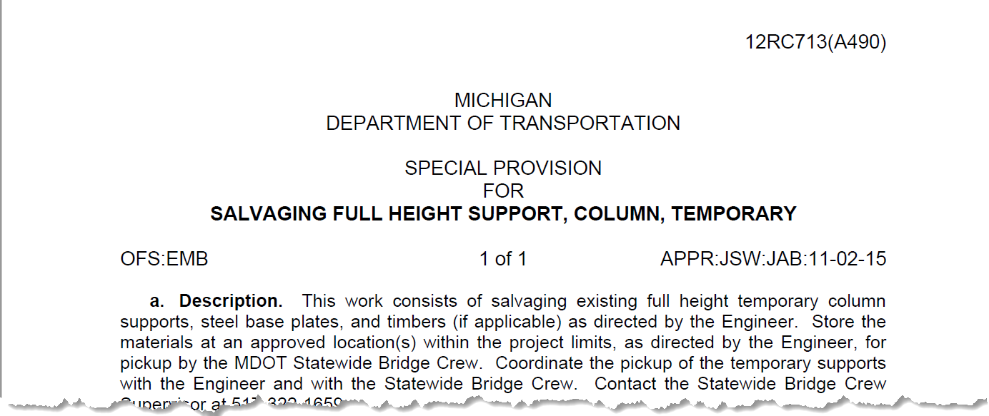
Previously Approved/Template Special Provisions
Notes:
We also incorporated several previously approved

Slide 7
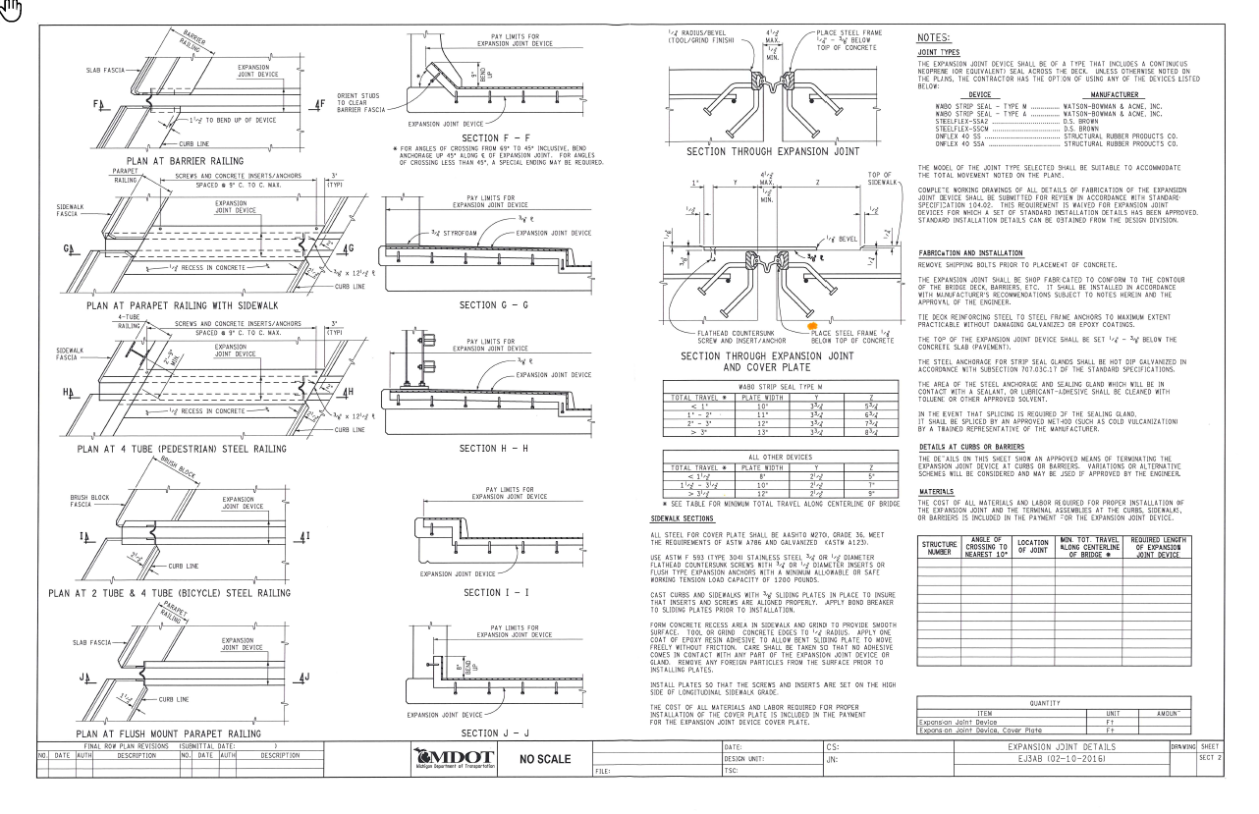
Use of Notes
Standard Notes reduced
AVOID Modifying standard notes
CAUTION use of notes for payment
Notes:
Reviewed std notes – reduce duplication where possible
Eliminate over 20 standard notes in chapter 8 of BDM
Notes used on EVERY JOB – by and large, incorporated
Material specifications should not be in a note – incorporated
Method of payment – not in note
Got us to thinking about challenges with notes
In general –
Do not repeat spec language
Do not modify standard notes – this creates confusion, especially if a word or words are changed
Be extremely careful when incorporating incidental items into standard pay items.
Going to scrutinize going forward.

Slide 8
Notable Changes

Slide 9
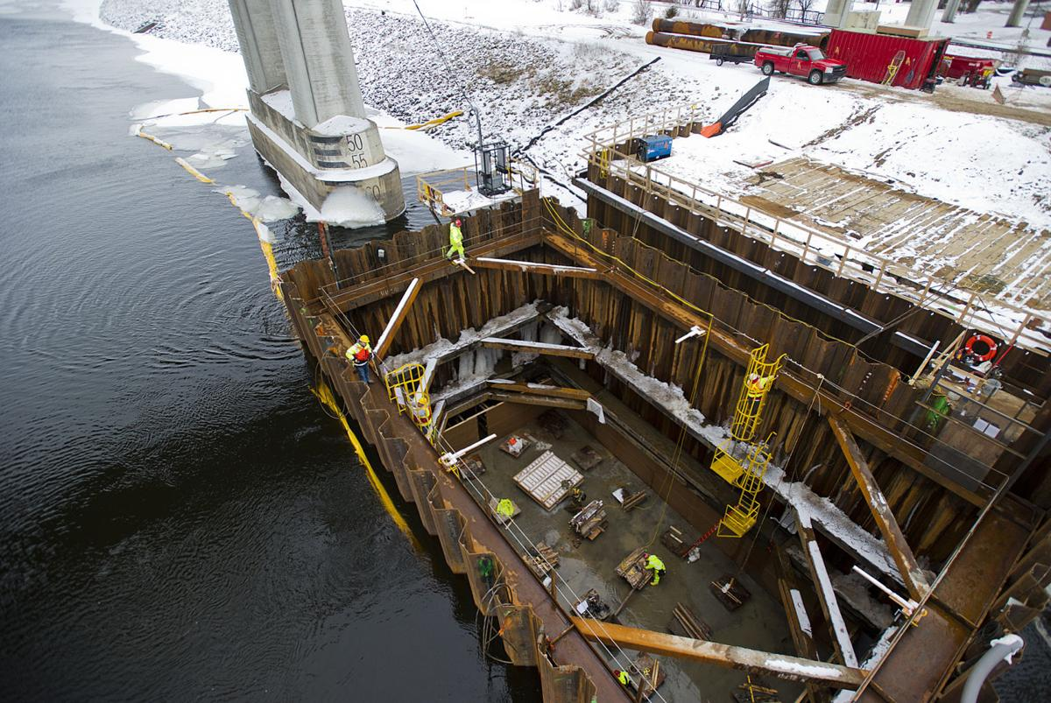
Notable Changes – 704 Sheet Pile/Cofferdams
Permanent Sheet Pile Installations – Division 9 material requirements
Cofferdams
6’ and greater - PE required
Tremie – must design to tremie design water height
Field Welding – AWS D1.1
Notes:
Add water inflow section.......

Slide 10
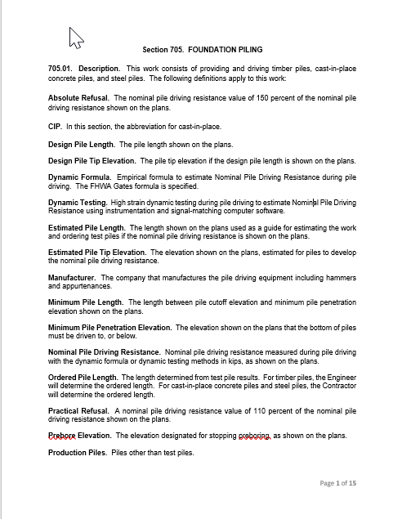
Notable Changes – 705 Foundation Piling
Definitions
Test Pile/Ordering
Redrive/Restrike

Slide 11
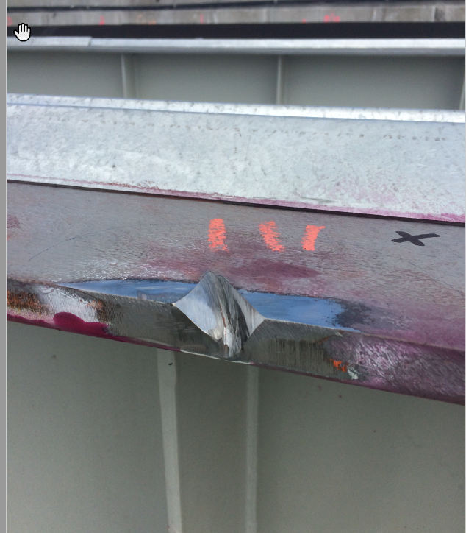
Notable Changes – 706 Structural Concrete
Conc Spec’d by Strength (e.g. 3500)
High Performance conc (e.g. 3500HP)
Expansion Joints – most notes incorporated
Falsework/forms – no welding to bridge!
SIP Forms – must have Styrofoam
No interruption of deck wet cure – period
Other concrete –3 days and 70%
Night pours – end 1 hour before sunrise
Pour sequence changes require 7-day notice
Notes:
Schedules will be affected!!
Barge after deck work is complee.
Strap wider than weld requirement.
Aesthetic texturing in, change abs forms.
Cold weather – 45 degrees, not 40. spec coming in future
No adjustments after test run.

Slide 12
Notable Changes – 707 & 708

Slide 13
Notable Changes – 707 – Structural Steel
Expanded applicability beyond bridge elements
Consistency with 708
Incorporated errata, FUSP, NSBA
Re-ordered to follow typical fab process
Fracture critical requirements incorporated
Notes:
Focus was to create a structural steel construction section that is applicable to structural steel and bridge fabrication. Prior version was more focused on bridge fabrication.
Harmonized with 708 (where applicable) and incorporated consistent terminology with other Structural Fabrication Unit documents.
Complete re-write to incorporate errata, FUSP, and other fabrication processes discussed in AASHTO LRFD Bridge Construction and AASHTO/NSBA (National Steel Bridge Alliance) Collaboration. For example, direction of rolling, low-stress die stamping, cold/hot bending requirements were incorporated among other changes.
Sections were reordered to follow typical fabrication process
Main member (in lieu of primary member), secondary member, and primary components were defined to match AASHTO for consistency
AISC audit reports and audit dates must be made available to MDOT if requested. This will give MDOT opportunity to better understand the fabricator’s QC program.
Fracture critical specifications were added in 707 (no longer need FUSP)
Welding was revised to clearly define bridge welding (D1.5) compared to structural steel welding (D1.1). Shop welding (D1.1 and D1.5) compared to field welding (D1.1 and D1.5).
High strength bolting was re-written to follow RCSC (Research Council of Structural Connections) and MDOT’s Field Manual for Structural Bolting. These three documents are now harmonized.
707 is significantly larger than before, but is more black and white

Slide 14
Notable Changes – 708 – Prestressed
Expanded applicability beyond bridge elements
Consistency with 707
Incorporated errata, FUSP, PCI
Tighter tolerance on strand tensioning
Revised specimen curing and testing
Notes:
Focus was to create a prestressed concrete section that was applicable to prestressed concrete beams and other prestressed elements. Less work here than 707.
Harmonized with 707 (where applicable) and incorporated consistent terminology with other Structural Fabrication Unit documents.
Complete re-write to incorporate errata, FUSP, and other fabrication processes discussed in PCI and other national codes. For example, oversized monolithic strand debonding requirements were incorporated among other changes.
Sections were reordered to follow typical fabrication process
PCI audit reports and audit dates must be made available to MDOT if requested. This will give MDOT opportunity to better understand the fabricator’s QC program.
MDOT historically required the fabricator to tension strands +5/-0%, which is different than PCI (+/-5%). This is now contractual 😊
Added items to Shop Inspection section that were included in 707, but missing in 708. For example, Facilities for Inspection and Shop Inspector’s Authority were absent in 708.
Numerous concrete casting requirements from 706 were either referenced or incorporated into 708, unless covered by PCI
(Precast/Prestressed Concrete Institute)
Revisions to molding & curing and testing & acceptance sections to clarify.
Added coating requirements for contractor add-ons, welding section referencing PCI (AWS D1.1), cold weather precautions (some shops cast outdoors)

Slide 15
Notable Changes – 711 Bridge Railings
Barrier replacement incorporated
Anchor bolts for lights – install only
Reworked pay items - consistent
Notes:
709 710 nothing notable
Elaborate on pay item changes?
Reconstruct barrier – mash.

Slide 16
Notable Changes – 712 Bridge Rehab - Concrete
Deck demo equipment size limited for steel beams
If contractor damages – PE for fix
Overlay changes
No heavy equipment on hydro’d deck
Scarify 1” from steel (must locate)
Must expose top reinf over 75% of test area
No interruption of wet cure
Pour at night
Notes:
Pin & hanger 3’ regardless
More detail on overlay requirements.

Slide 17
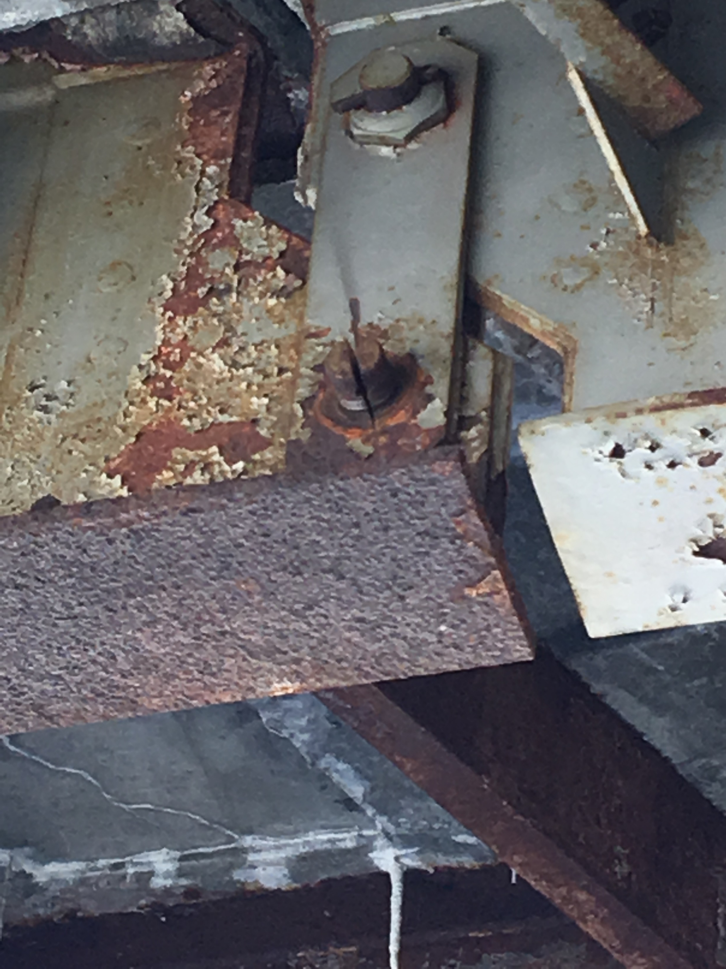
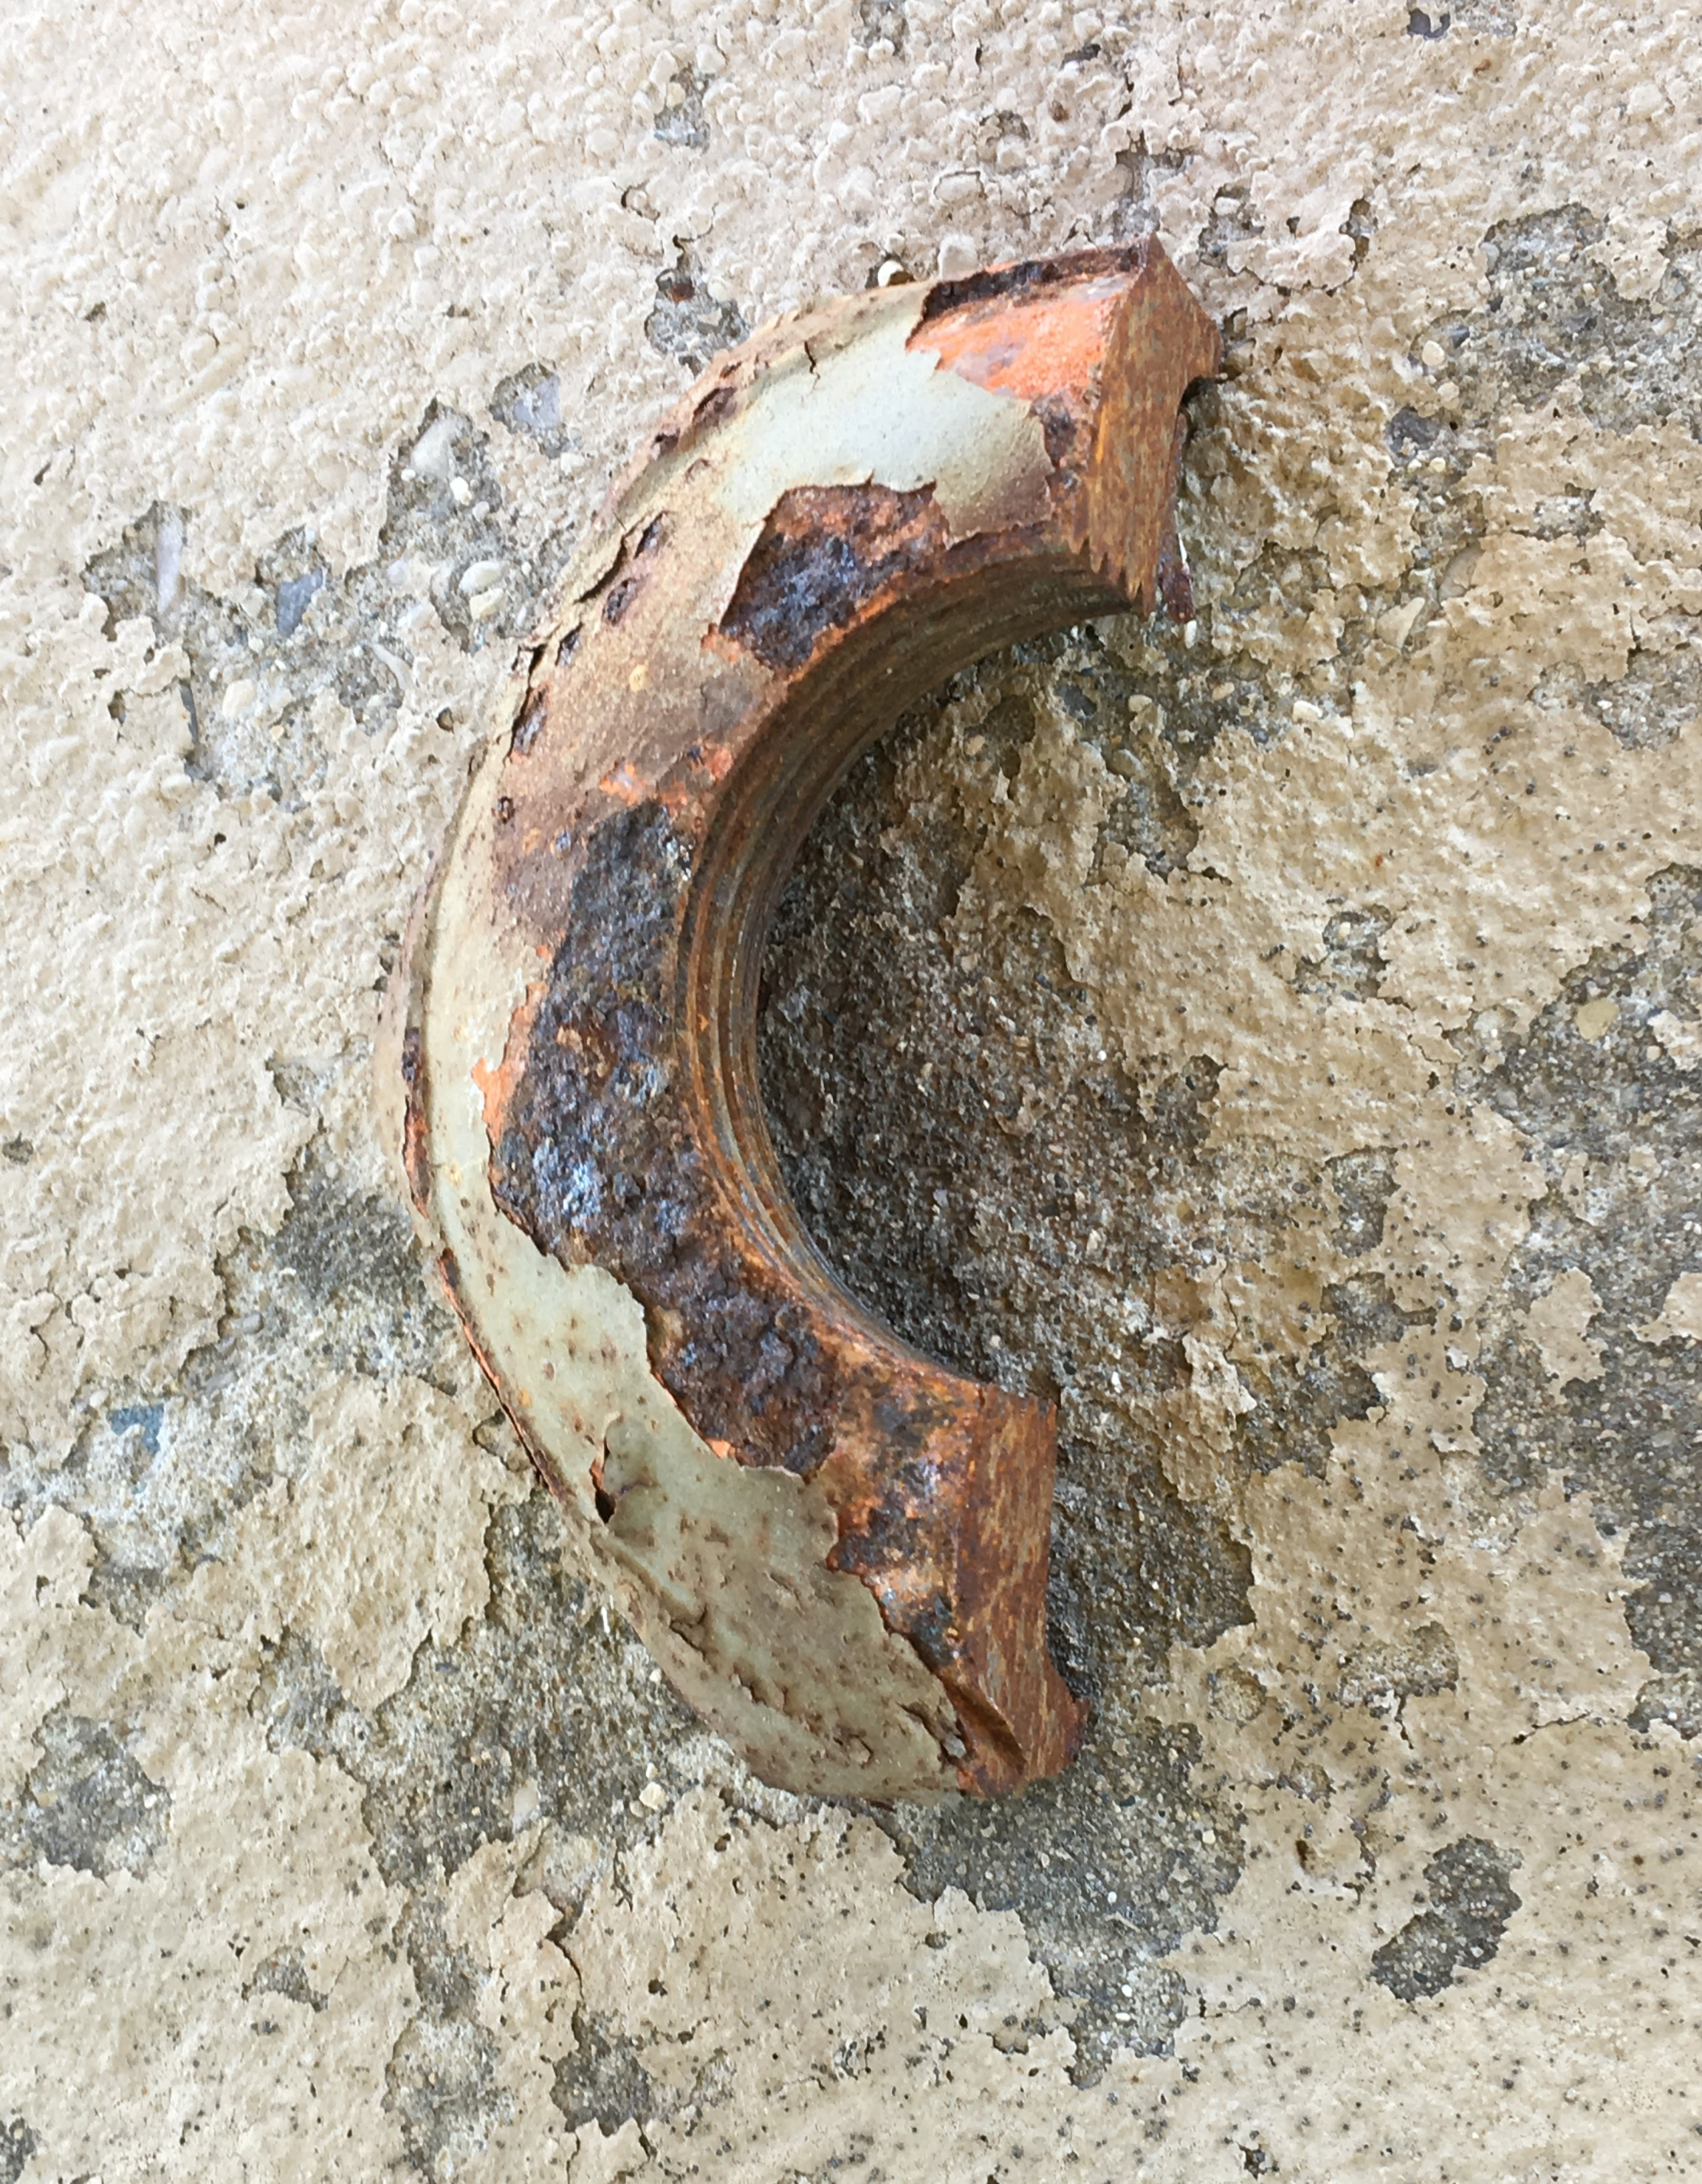
Notable Changes – 713 Bridge Rehab - Steel
PE for pin plate damage
Heat straightening spec incorporated (mostly)
Temp support includes lateral bracing
Prohibited pin & hanger damage when measuring

Slide 18
Notable Changes – 713 Bridge Rehab - Steel
Minor change to incorporate FUSP
Major overhaul forthcoming

Slide 19
Notable Changes – 715/716 Clean & Coat Steel
Field – need 1’ overlap of enclosure between stages
Stenciling – inside of fascia
716 Shop Painting – deleted repeated info
Notes:
714, nothing notable

Slide 20
Notable Changes – 718 Drilled Shafts
We will now pay for reinforcement!

Slide 21
Construction Manual
False Decking
Welding Requirements
Field Measurements Reporting
Hydrodemolition Calibration and Equipment
Cofferdam Elevations and Dewatering Requirements
And Many, Many, Many More …..
Notes:
John - Go over things were going to add to the construction manual.

Slide 22
Special Provisions
Notes:
Don’t change it unless you need to.
Follow the book whenever you can
Common issues.

Slide 23
Division 7 Final Notes
Retained FUSP’s being updated
Construction Wiki Update – Fall 2020
PASP’s must be re-approved
Minimize Non-standard notes
Conc Curing = Additional Time
Notes:
Give detail on notes?
If you have a question, call us – don’t assume.

