Slide 1
FUSPs BY DIVISION
# of 2012 FUSPs # of FUSPs deleted # of FUSPs Remaining
Division 1: 39 21 18
Division 2: 7 0 7
Division 3: 4 3 1
Division 4: 8 3 5
Division 5: 37 7 30
Division 6: 12 7 5
Division 7: 45 18 27
Division 8: 130 54 76
Division 9: 22 17 5
Totals 304 130 174

Slide 2
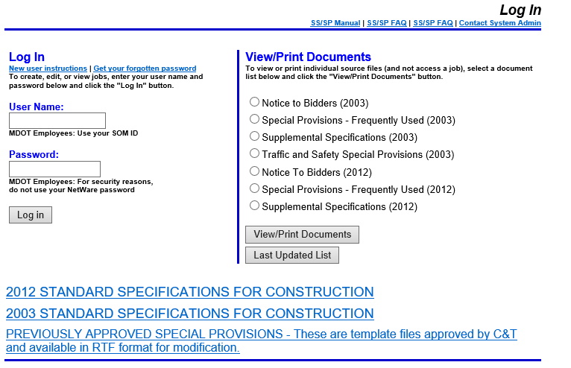

Slide 4
